Slide 1

Exploratory Data Analysis
G2M Insight cab investment firm
20th April 2023

Slide 2

Agenda
Executive Summary
Problem Statement
Approach
EDA
EDA Summary
Recommendations

Slide 3
Executive Summary
XYZ is a private firm in the US. Due to remarkable growth in the Cab Industry in the last few years and multiple key players in the market, it is planning for an investment in the Cab industry

Slide 4
Problem Statement
Provide XYZ with actionable insights to help them understand the cab market in the USA and identify the right company to make their investment.

Slide 5
Approach
Define the problem
Collect, explore and understand the data
Cleaning and preparing the Data
Statistical analysis
Recommendations

Slide 6

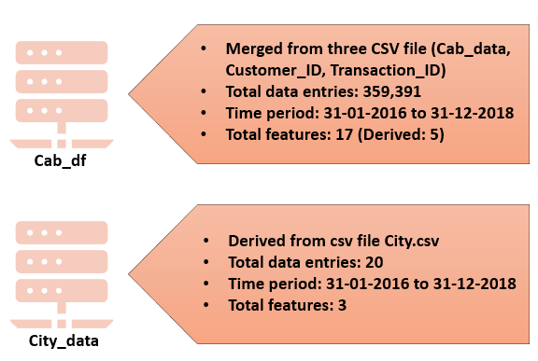
Cleaning and preparing the data
Assumptions:
The Customer ID is a unique identifier that remains consistent across different companies and systems.
The Price charged and Cost of Trip variables are expressed in the same currency unit, namely USD.

Slide 7
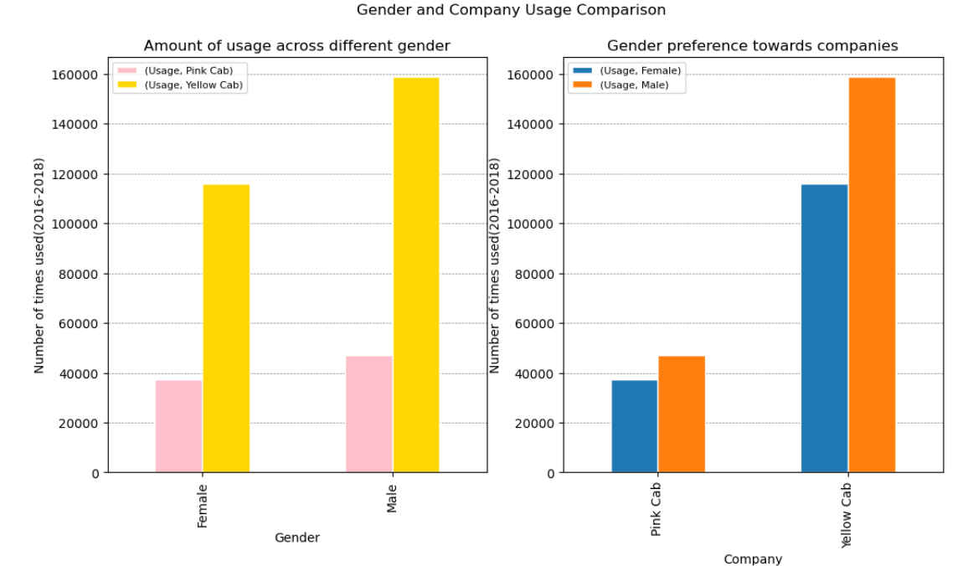
Statistical Analysis (Understanding the cab market)
Does the cab company’s preference depend on the gender of the customer?
Although yellow cabs were found to be more frequently used by both men and women, the difference between the percentage of male and female travellers was minimal or nearly identical across both cab companies. This shows that there is no significant correlation between the gender of the customer and the cab company’s preference.

Slide 8
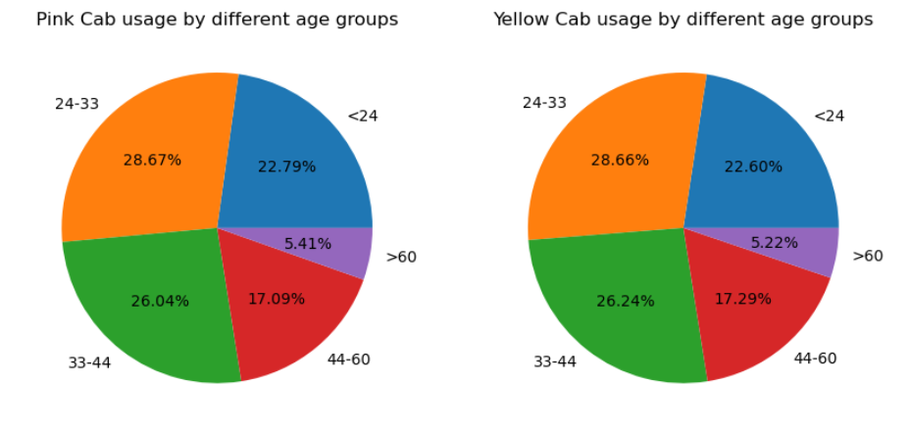
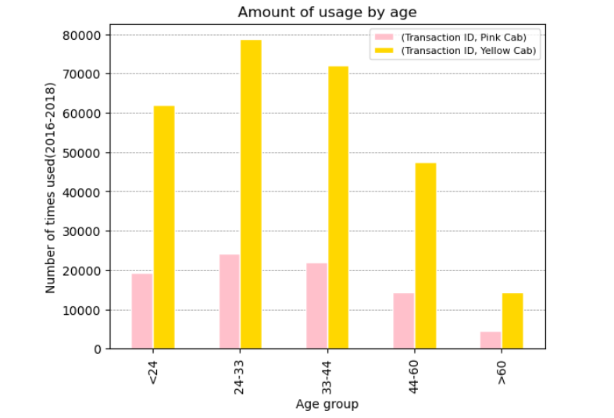
Statistical Analysis (Understanding the cab market)
The age groups 24-33 and 33-44 account for a relatively higher number of customers for both companies. Understandably, people above 60 years of age are seen travelling less
Do different age groups prefer different cab companies?
The pie chart shows that both companies have a similar proportion of customer base across all age groups and no particular age group is completely inclined towards one specific cab company . There is no significant correlation between the age group of the customer and the usage of cab services from a particular company.

Slide 9
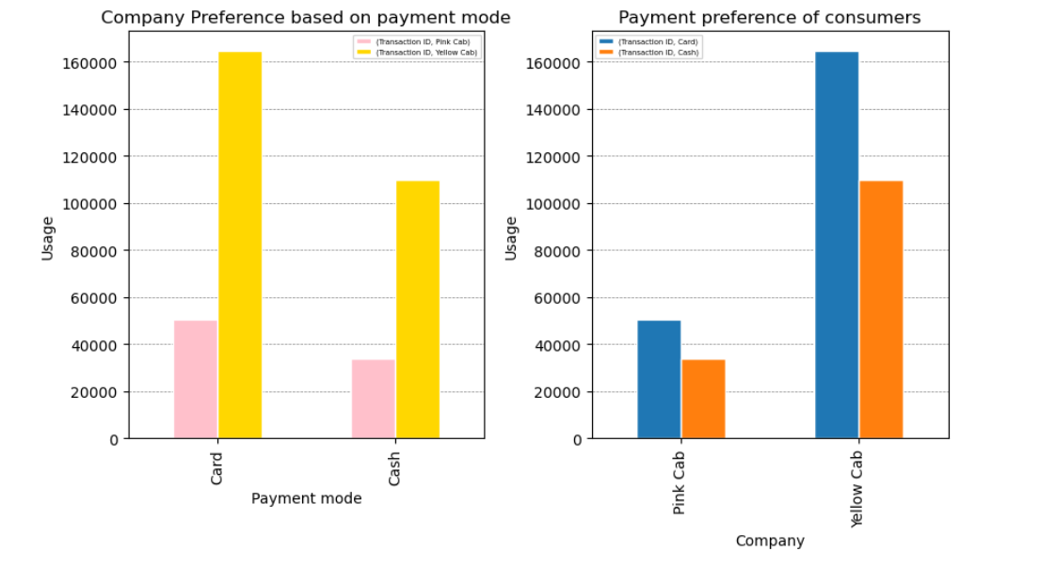

Statistical Analysis (Understanding the cab market)
Does the payment mode affect the customer’s choice of cab company?
Both cash payment and card payment modes have similar trends across both companies. While the yellow cab company has a higher customer base, it is evident from the second graph that the proportion of card and cash payments is identical for both companies. Therefore, payment mode does not seem to significantly impact the cab company's choice.
On the whole, the number of card payments is higher than the number of cash payments, indicating the customers’ preference for card payments. Companies should take note of this trend and make necessary accommodations to meet customers' payment preferences.

Slide 10
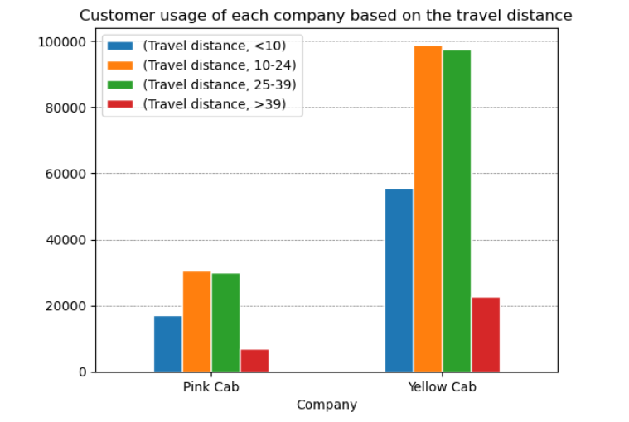
Statistical Analysis (Understanding the cab market)
Is there a correlation between the travel distance and the preference for a cab company by customers?
The majority of customers from both Yellow and Pink cab companies are travelling distances between 10 and 39 kilometres. This indicates that there is a higher demand for cabs for mid-range distances compared to shorter or longer distances. However, the analysis doesn't reveal any preference for cab companies based on travel distance. The proportions of customers travelling different distances are similar for both companies

Slide 11
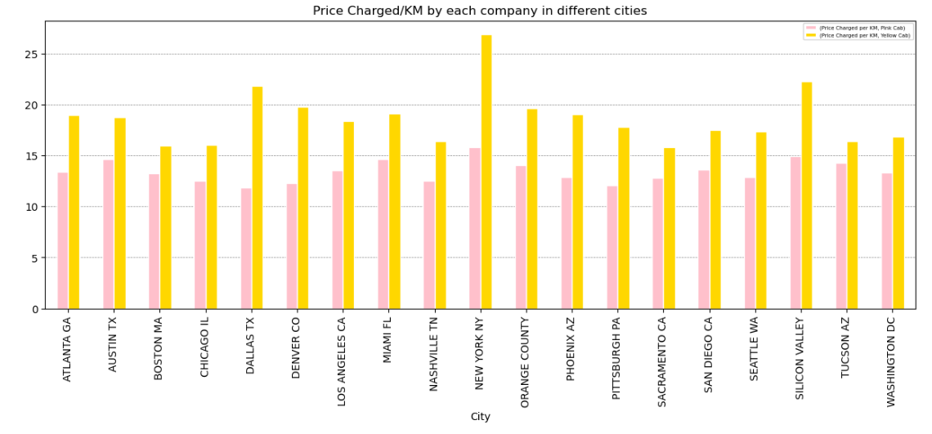
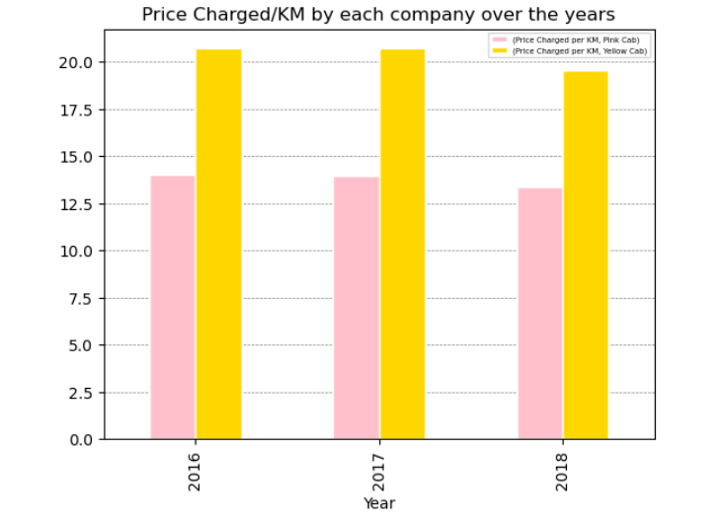
Statistical Analysis
Is there a difference in the prices charged per kilometre by each company over the years?
Both companies maintained consistent pricing across the three-year period. However, Yellow cabs charged a higher fare per kilometre than Pink cabs in all the cities. This could suggest that Yellow Cab is positioning itself as a premium cab service compared to Pink Cab, or it may be incurring higher costs per kilometre due to offering better service or infrastructure.

Slide 12
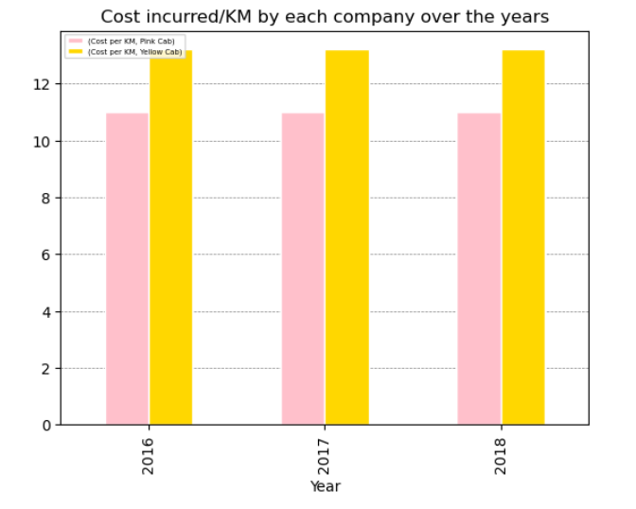
Statistical Analysis
Does the cost incurred by each company per kilometre answer the higher charges of Yellow Cab Company?
Yellow cabs are incurring a higher cost per kilometre on average compared to Pink cabs. Interestingly, this cost has remained consistent for both companies over the three-year period. This may indicate that Yellow Cab is investing more in maintaining and upgrading its infrastructure, which could be a contributing factor to its higher pricing per kilometre. Alternatively, this could mean that Pink Cab is operating with a more cost-efficient model.

Slide 13
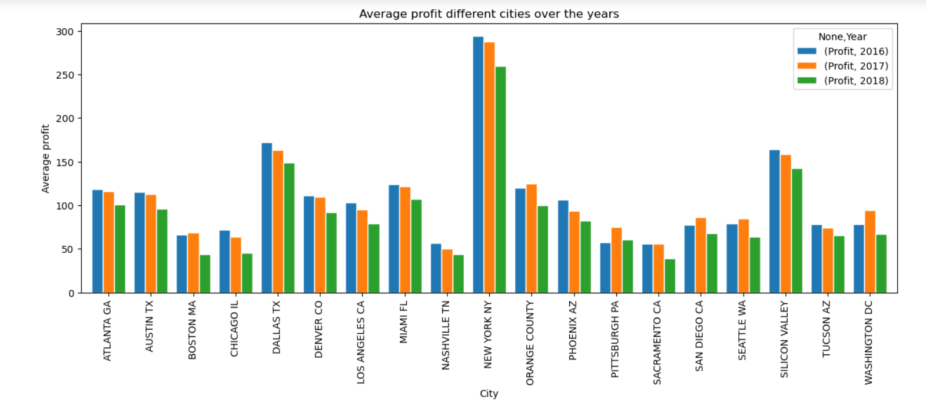
Statistical Analysis
Some cities tend to generate more profits for companies compared to others. Interestingly, the profits earned by companies remained consistent throughout the years across all the cities. This suggests that some cities offer more favourable business environments for companies compared to others, possibly due to factors such as a larger customer base, better infrastructure, or lower operating costs.

Slide 14
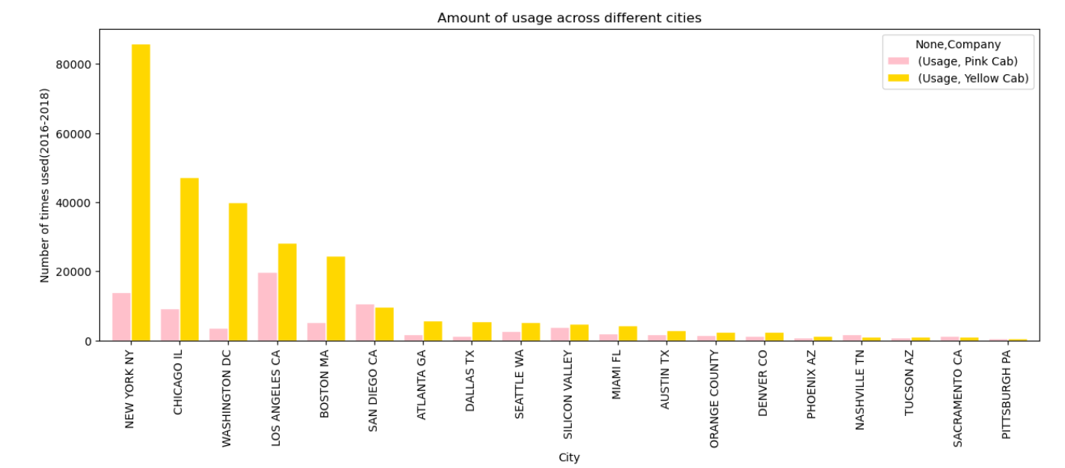
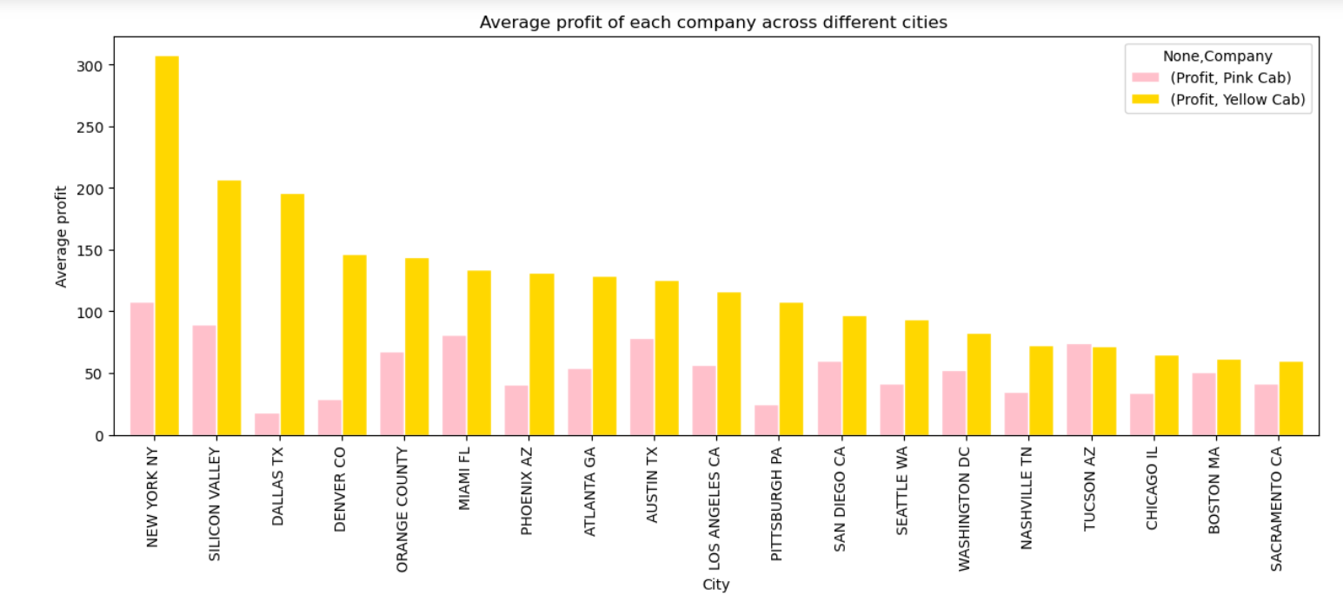
Statistical Analysis
The yellow cab company earned relatively high profits from almost all cities. These findings suggest that while some cities may offer similar profits to both companies, there are instances where profitability may differ significantly between companies in the same city. This underscores the importance of conducting a detailed analysis of the local market conditions to gain a better understanding of the profitability potential in each city.
Additionally, there is no clear relationship between the number of users and profits in most cities. For instance, in cities such as Dallas and Silicon Valley, where profits were relatively high, the usage of cabs was comparatively low.

Slide 15
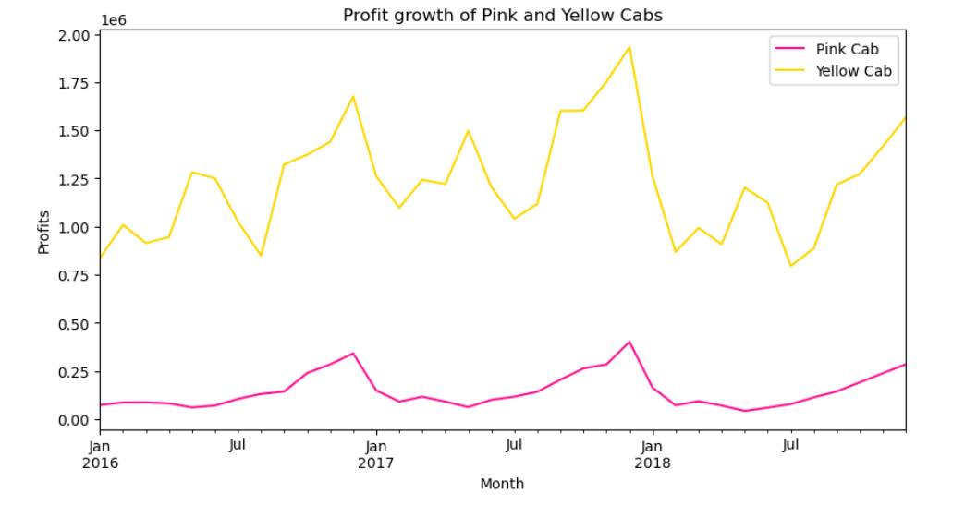
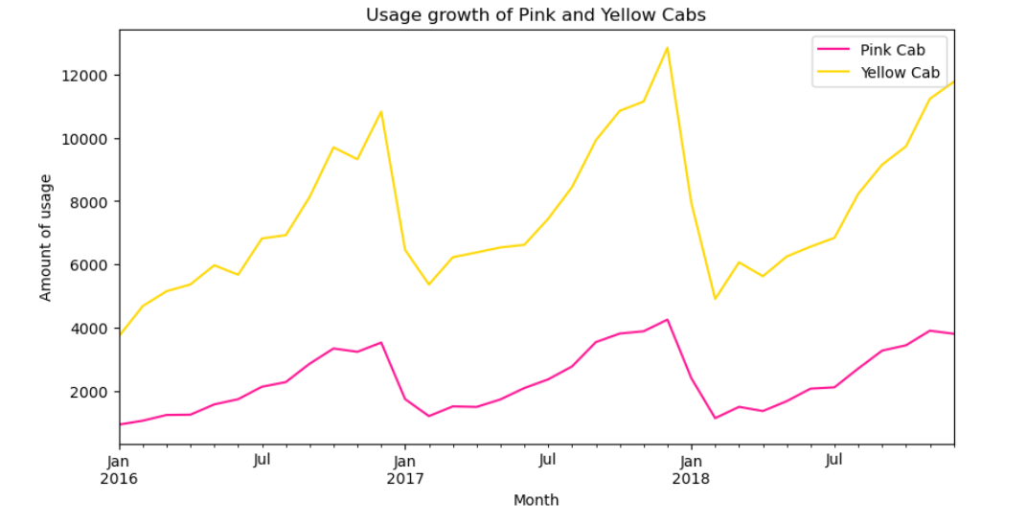
Statistical Analysis
Similar to that of profits, there is a steady increase in the number of users for both cab companies over the years, suggesting that their popularity has been on the rise.
Both companies have experienced steady profit growth over the years. Although the growth rate is moderate, it is consistent and indicates a positive trend in the financial performance of both companies. However, the profit margin of Yellow Cab is relatively very high and it would take a considerable time for Pink Cab company to reach profits if the Yellow Cab Company

Slide 16
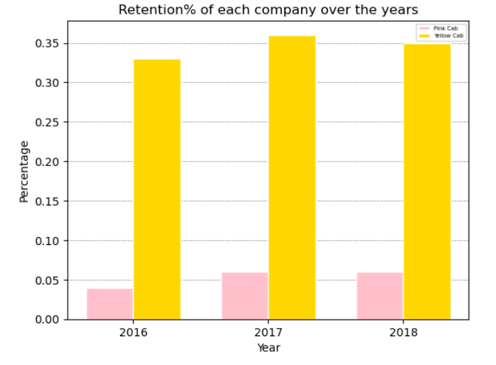
Statistical Analysis
Yellow cab has a higher retention rate compared to Pink cab. This indicates that more customers are likely to return to Yellow Cab for their future rides, possibly due to a higher level of satisfaction with the service provided.
The higher retention rate also indicates that the usage growth rate could be higher for Yellow Cab Company going forward

Slide 17
Recommendations
Based on the EDA results, it appears that Yellow Cab is currently in a stronger position than Pink Cab, as it has a larger customer base, more consistent profits, and higher usage rates in most cities. Investing in Yellow Cab could therefore be a more promising opportunity, with potentially quicker returns on investment.

Slide 18
.
Thank You

